Slide 1
EQUIPMENT’S CLASSROOM MANAGEMENT
Group 10:
Trần Vĩnh Quang – SE61078
Tăng Việt Hưng – SE61019
Đoàn Nguyễn Minh Chí – SE60717
Supervisor:
Kiều Trọng Khánh

Slide 2
OUTLINE
Current Situation
Solution
Demonstration
Advantages and Disadvantages
Future plan
Question and Answers

Slide 3


CURRENT SITUATION
Staff

Slide 4
CURRENT SITUATION
Number of equipment
Status of equipment
Damage of equipment
Staff
Time remain of equipment

Slide 5
CURRENT SITUATION
1
Managing equipment is manual

Slide 6


CURRENT SITUATION
Teacher
6

Slide 7
CURRENT SITUATION
Staff
Teacher
7

Slide 8
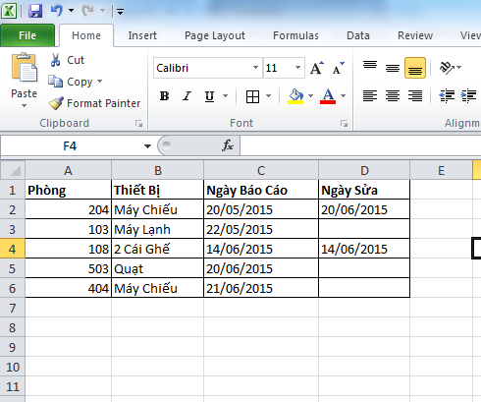
CURRENT SITUATION
Check history of equipment

Slide 9
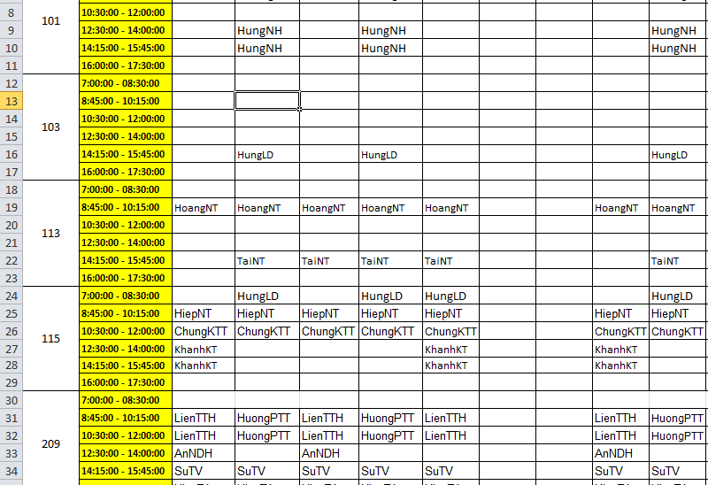
CURRENT SITUATION
Find available room

Slide 10
CURRENT SITUATION
Staff
Teacher
10

Slide 11
CURRENT SITUATION
1
Managing equipment is manual
2
Waste time when receive and resolve report

Slide 12
CURRENT SITUATION
How to notice other teacher ?

Slide 13
CURRENT SITUATION
Notice in classroom

Slide 14
CURRENT SITUATION
Notice to teacher

Slide 15
CURRENT SITUATION
1
Managing equipment is manual
2
Waste time when receive and resolve report
3
Hard to notice when needed

Slide 16
CURRENT SITUATION
1
Managing equipment is manual
2
Waste time when receive and resolve report
3
Hard to notice when needed
4
Require human resource

Slide 17
SOLUTION
ECRM
Teacher

Slide 18
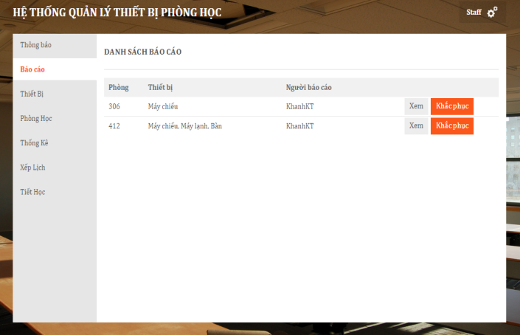
SOLUTION
ECRM

Slide 19
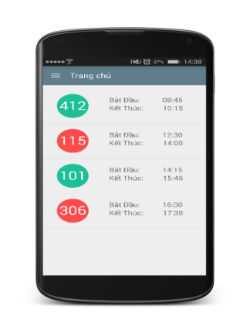
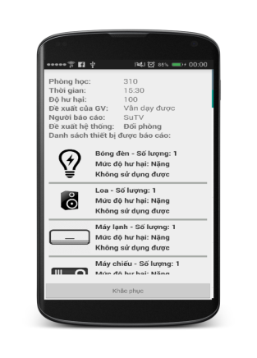
SOLUTION
ECRM

Slide 20
SOLUTION
ECRM

Slide 21
SOLUTION
Managing equipment is automatic
ECRM

Slide 22
SOLUTION
Managing equipment is automatic
Automatically receive and analyze data report
ECRM

Slide 23
SOLUTION
Managing equipment is automatic
Automatically receive and analyze data report
ECRM
Notice based on SMS and notification in real time

Slide 24
SOLUTION
Managing equipment is automatic
Automatic receive and analyze data report
ECRM
Notice based on SMS and notification in real time
Require less human resource

Slide 25
CLASSROOM
CLASSROOM OBJECT
ClassName
NumberSlot

Slide 26
CLASSROOM
CLASSROOM OBJECT
ClassName
NumberSlot
EQUIPMENT CATEGORY OBJECT
ClassName
Name
0.. *

Slide 27
CLASSROOM
CLASSROOM OBJECT
ClassName
NumberSlot
EQUIPMENT CATEGORY OBJECT
ClassName
Name
0.. *
0.. *

Slide 28
CLASSROOM
ROOMTYPE OBJECT
CLASSROOM OBJECT
ClassName
NumberSlot
EQUIPMENT CATEGORY OBJECT
Name

Slide 29
CLASSROOM
ROOMTYPE OBJECT
RoomTypeId
0..1
CLASSROOM OBJECT
ClassName
NumberSlot
RoomTypeId
EQUIPMENT CATEGORY OBJECT
Name
0..*

Slide 30
CLASSROOM
ROOMTYPE OBJECT
RoomTypeId
0..1
0..*
CLASSROOM OBJECT
ClassName
NumberSlot
RoomTypeId
EQUIPMENT CATEGORY OBJECT
Name
1..*
0..*

Slide 31
CLASSROOM
ROOMTYPE OBJECT
RoomTypeId
0..1
0..*
CLASSROOM OBJECT
ClassName
NumberSlot
RoomTypeId
EQUIPMENT CATEGORY OBJECT
Name
1..*
0..*

Slide 32
CLASSROOM
EQUIPMENT QUANTITY OBJECT
RoomTypeID
EquipmentName
Quantity
Priority
0..*
0..*
EQUIPMENT CATEGORY OBJECT
Name
ROOMTYPE OBJECT
RoomTypeID
1..1
1..1

Slide 33
CLASSROOM
CLASSROOM OBJECT
ClassName
NumberSlot
RoomTypeID

Slide 34
CLASSROOM
CLASSROOM OBJECT
ClassName
NumberSlot
RoomTypeID
ROOMTYPE OBJECT
RoomTypeID
0..*
1..1

Slide 35
CLASSROOM
CLASSROOM OBJECT
ClassName
NumberSlot
RoomTypeID
ROOMTYPE OBJECT
RoomTypeID
0..*
1..1
1..1
0..*
EQUIPMENT QUANTITY OBJECT
RoomTypeID
EquipmentName
Quantity
Priority

Slide 36
CLASSROOM
CLASSROOM OBJECT
ClassName
NumberSlot
RoomTypeID
ROOMTYPE OBJECT
RoomTypeID
0..*
1..1
1..1
0..*
EQUIPMENT QUANTITY OBJECT
RoomTypeID
EquipmentName
Quantity
Priority
EQUIPMENT CATEGORY OBJECT
Name
1..1
0..*

Slide 37
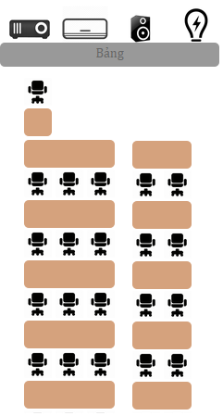

ROOM TYPE

Slide 38
ROOM TYPE
ROOMTYPE OBJECT
RoomTypeID
Name
VerticalRows

Slide 39
ROOM TYPE
ROOMTYPE OBJECT
RoomTypeID
Name
VerticalRows
HorizontalRows

Slide 40
ROOM TYPE
ROOMTYPE OBJECT
RoomTypeID
Name
VerticalRows
HorizontalRows
NumberOfSlotsEachHRows

Slide 41
ROOM TYPE
ROOMTYPE OBJECT
RoomTypeID
Name
VerticalRows
HorizontalRows
NumberOfSlotsEachHRows
1..1
0..*
EQUIPMENT QUANTITY OBJECT
RoomTypeID
EquipmentName

Slide 42
SCHEDULE
Update equipment using time
Why need schedule ?

Slide 43
SCHEDULE
Update equipment using time
Why need schedule ?
Find available room when needed

Slide 44
SCHEDULE
Update equipment using time
Why need schedule ?
Find available room when needed
Check report of user

Slide 45
SCHEDULE
SCHEDULE OBJECT
Username
ClassName
ScheduleConfigID
Date
SCHEDULE CONFIG OBJECT
Slot
TimeFrom
TimeTo
0..*
1..1

Slide 46
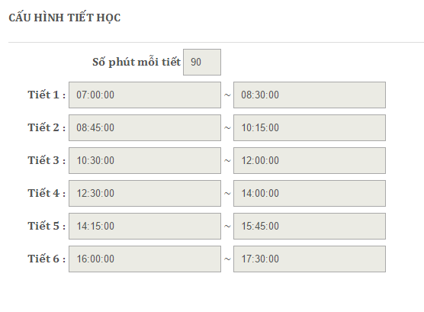
SCHEDULE
Configure Schedule

Slide 47
SCHEDULE
Configure Schedule
SCHEDULE CONFIG OBJECT
Slot
TimeFrom
TimeTo

Slide 48
SCHEDULE
Configure Schedule
SCHEDULE CONFIG OBJECT
Slot
TimeFrom
TimeTo

Slide 49
SCHEDULE
Configure Schedule
SCHEDULE CONFIG OBJECT
Slot
TimeFrom
TimeTo

Slide 50
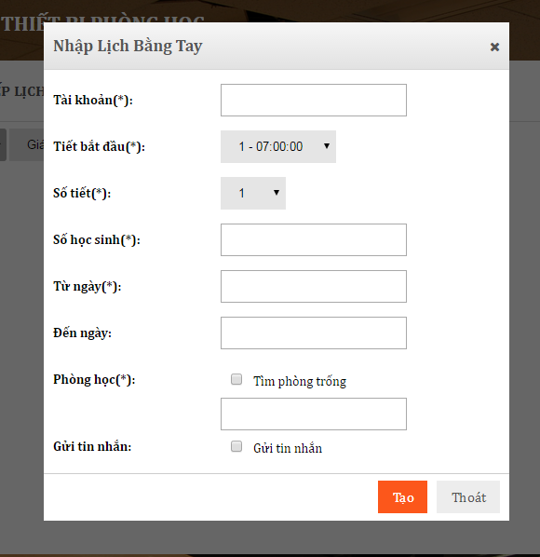
SCHEDULE
Manual
1
2
SCHEDULE OBJECT
Username
ClassName
ScheduleConfigID
NoStudents
Date
SCHEDULE CONFIG OBJECT
Slot
TimeFrom
TimeTo

Slide 51
SCHEDULE
Manual
1
2
SCHEDULE OBJECT
Username
ClassName
ScheduleConfigID
NoStudents
Date
SCHEDULE CONFIG OBJECT
Slot
TimeFrom
TimeTo

Slide 52
SCHEDULE
Manual
1
2
SCHEDULE OBJECT
Username
ClassName
ScheduleConfigID
NoStudents
Date
SCHEDULE CONFIG OBJECT
Slot
TimeFrom
TimeTo

Slide 53
SCHEDULE
Manual
1
2
SCHEDULE OBJECT
Username
ClassName
ScheduleConfigID
NoStudents
Date
SCHEDULE CONFIG OBJECT
Slot
TimeFrom
TimeTo

Slide 54
SCHEDULE
Import File

Slide 55
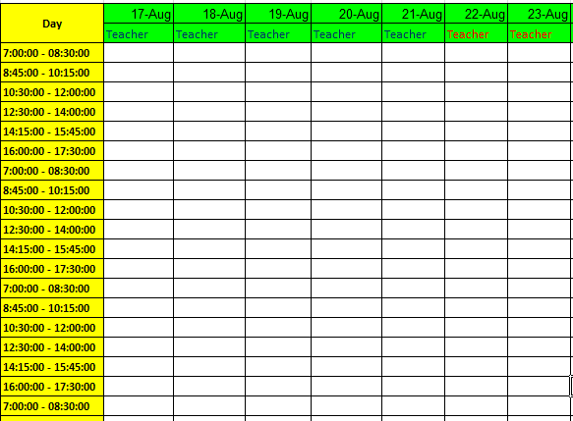
SCHEDULE
Import File
1
Download template from server

Slide 56
SCHEDULE
Import File
1
2
Download template from server
Fill to template

Slide 57
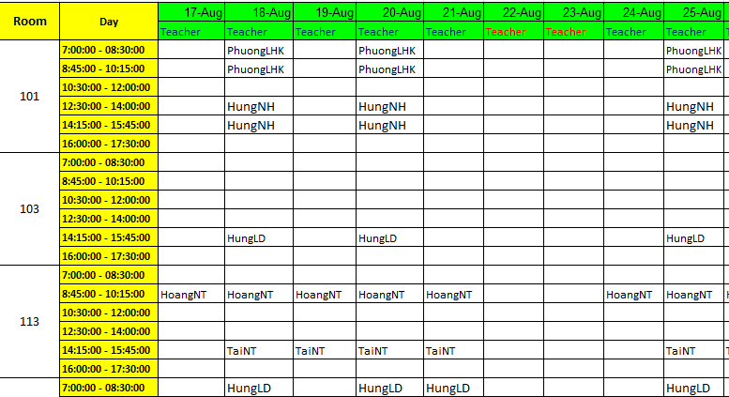
SCHEDULE

Slide 58
SCHEDULE
Import File
1
2
3
Download template from server
Fill to template
Import to server

Slide 59

REPORT DAMAGED EQUIPMENT

Slide 60
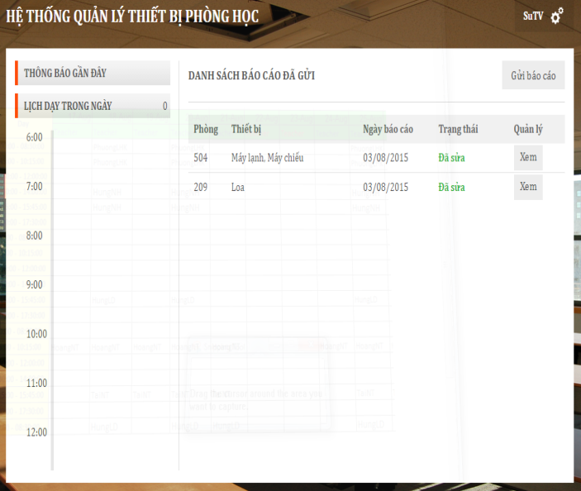
REPORT DAMAGED EQUIPMENT

Slide 61

REPORT DAMAGED EQUIPMENT

Slide 62
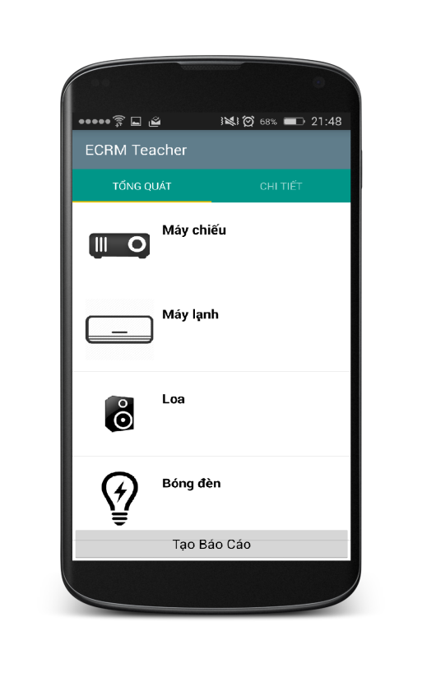
REPORT DAMAGED EQUIPMENT
Step 1:
Choose damaged equipment and evaluate

Slide 63

REPORT DAMAGED EQUIPMENT
Step 2:
Send report to server

Slide 64
REPORT DAMAGED EQUIPMENT
REPORT OBJECT
Username
ClassName
Evaluate
Date
1..1
0..*
REPORT DETAIL OBJECT
EquipmentName
DamageLevel
Evaluate

Slide 65
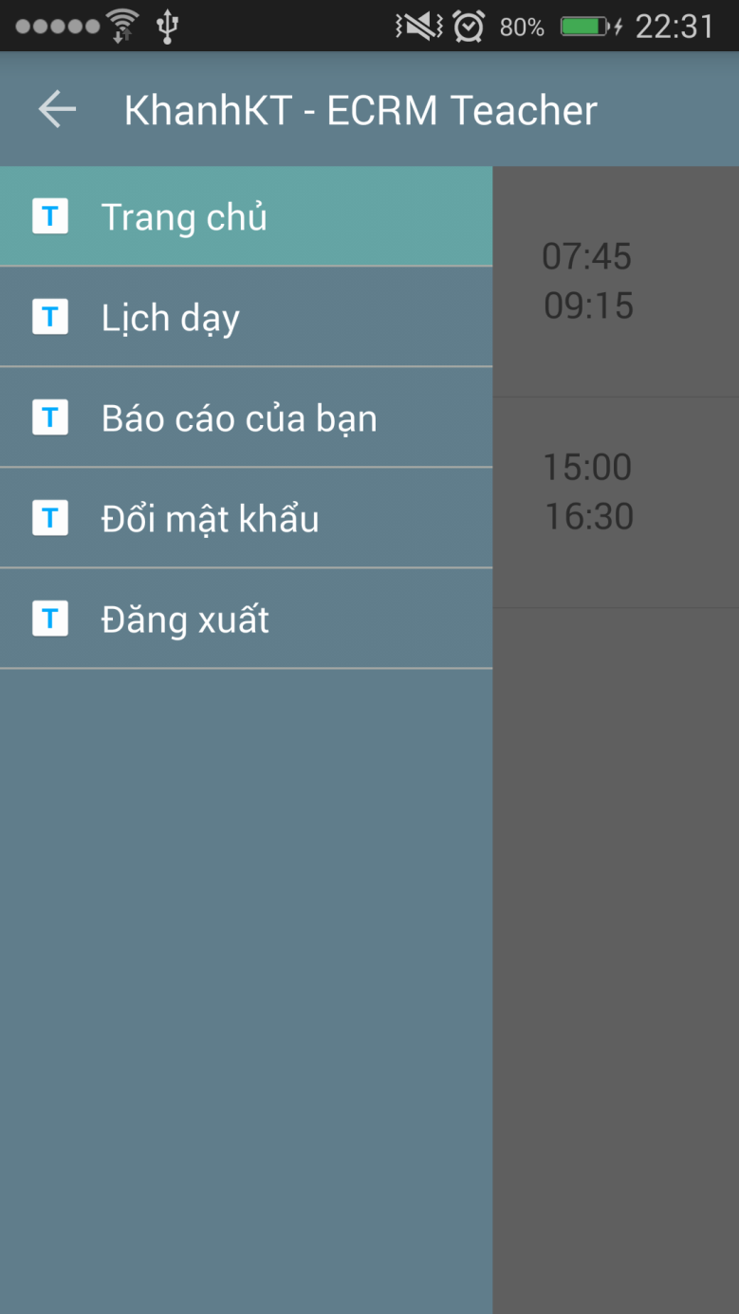
REPORT DAMAGED EQUIPMENT
REPORT OBJECT
Username
ClassName
Evaluate
Date
1..1
0..*
REPORT DETAIL OBJECT
EquipmentName
DamageLevel
Evaluate

Slide 66
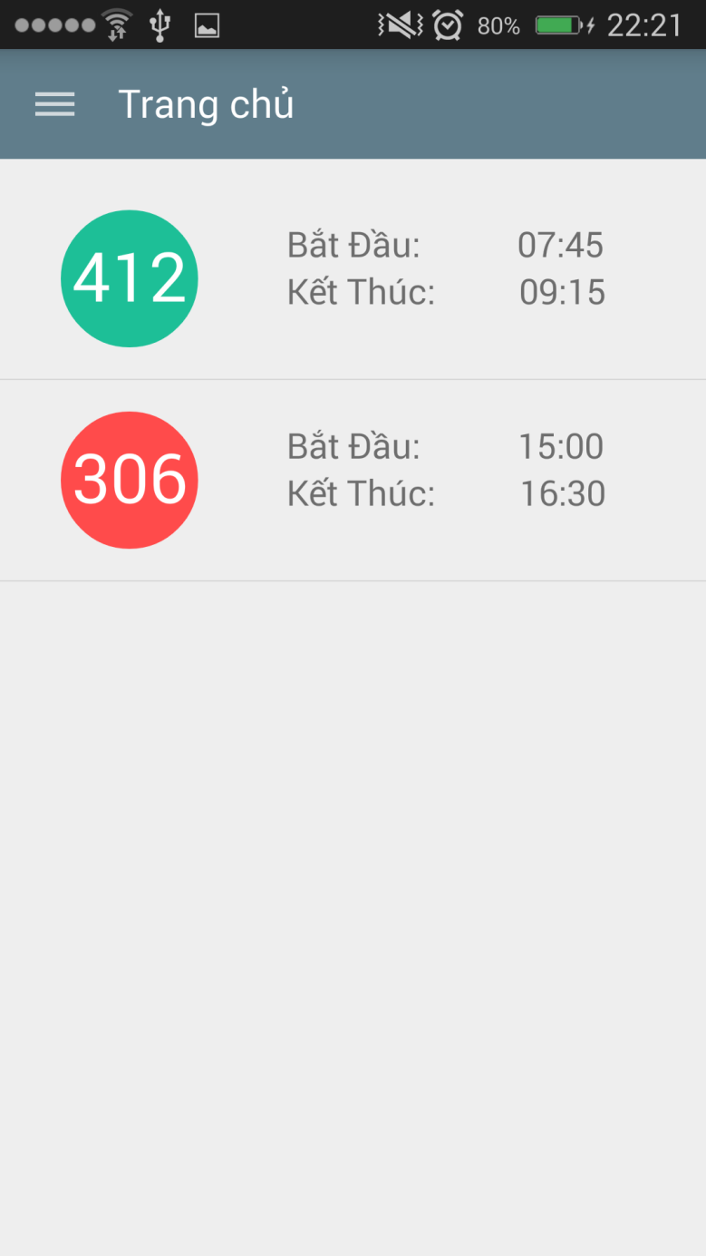
REPORT DAMAGED EQUIPMENT
REPORT OBJECT
Username
ClassName
Evaluate
Date
1..1
0..*
REPORT DETAIL OBJECT
EquipmentName
DamageLevel
Evaluate

Slide 67
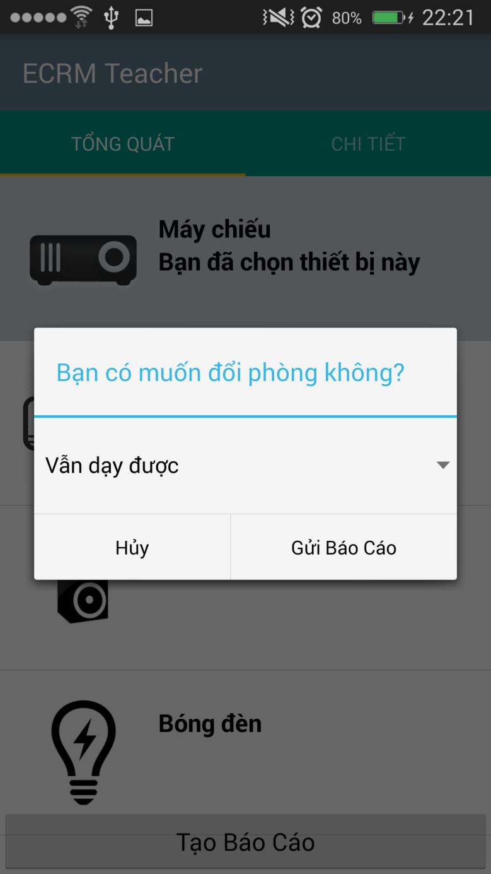
REPORT DAMAGED EQUIPMENT
REPORT OBJECT
Username
ClassName
Evaluate
Date
1..1
0..*
REPORT DETAIL OBJECT
EquipmentName
DamageLevel
Evaluate

Slide 68
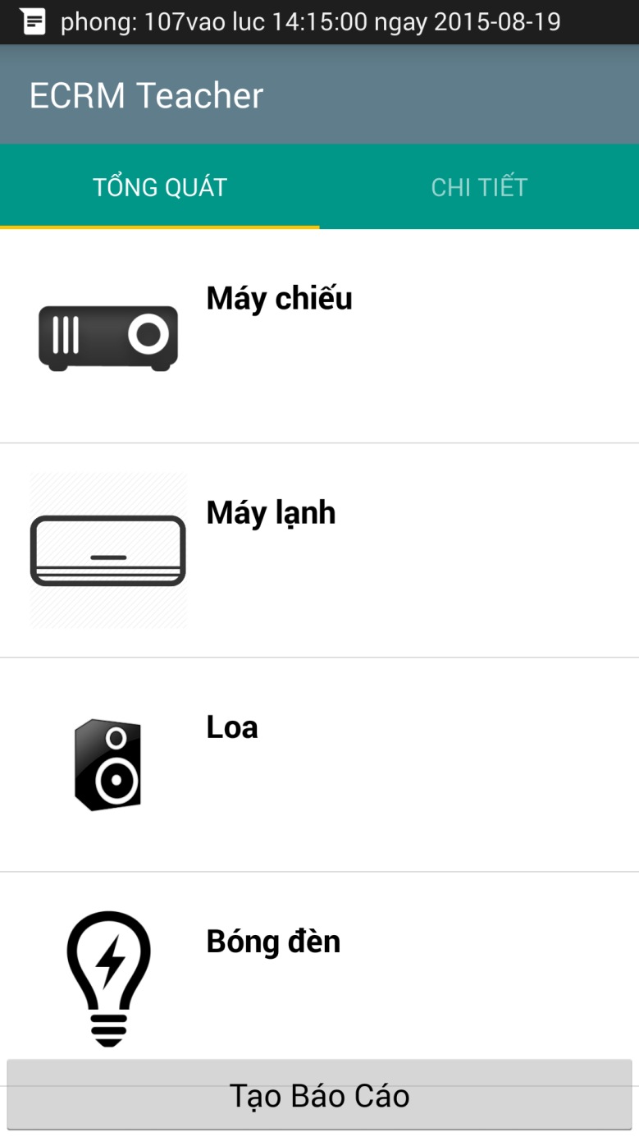
REPORT DAMAGED EQUIPMENT
REPORT OBJECT
Username
ClassName
Evaluate
Date
1..1
0..*
REPORT DETAIL OBJECT
EquipmentName
DamageLevel
Evaluate

Slide 69
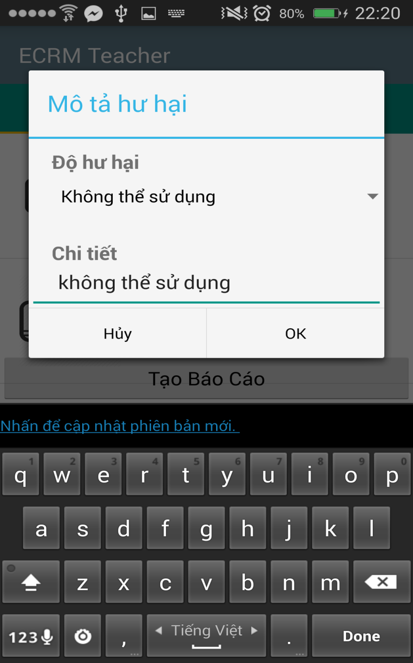
REPORT DAMAGED EQUIPMENT
REPORT OBJECT
Username
ClassName
Evaluate
Date
1..1
0..*
REPORT DETAIL OBJECT
EquipmentName
DamageLevel
Evaluate

Slide 70
REPORT DAMAGED EQUIPMENT
REPORT OBJECT
Username
ClassName
Evaluate
Date
1..1
0..*
REPORT DETAIL OBJECT
EquipmentName
DamageLevel
Evaluate

Slide 71

REPORT DAMAGED EQUIPMENT
Step 3:
Save data to database

Slide 72
REPORT DAMAGED EQUIPMENT
Step 4:
Notify to staff

Slide 73

REPORT DAMAGED EQUIPMENT
Step 5:
Analyze data from report

Slide 74
REPORT DAMAGED EQUIPMENT
Step 6:
Send notification to teacher

Slide 75

REPORT DAMAGED EQUIPMENT
Step 7:
Send notification to another teacher

Slide 76
ANALYZE DATA AND MAKING DECISION

Slide 77
ANALYZE DATA AND MAKING DECISION
REPORT OBJECT
Username
ClassName
Evaluate
Date
1..1
0..*
REPORT DETAIL OBJECT
EquipmentName
DamageLevel
Evaluate

Slide 78
ANALYZE DATA AND MAKING DECISION
REPORT OBJECT
Username
ClassName
Evaluate
Date
ROOM TYPE OBJECT
NoSlots
List Equipments
List Equipment’s Priority
1..1
0..*
REPORT DETAIL OBJECT
EquipmentName
DamageLevel
Evaluate

Slide 79

ANALYZE DATA AND MAKING DECISION

Slide 80
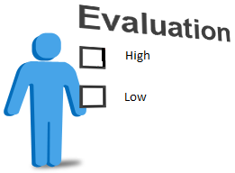
ANALYZE DATA AND MAKING DECISION

Slide 81

ANALYZE DATA AND MAKING DECISION
High
Medium
Low

Slide 82
ANALYZE DATA AND MAKING DECISION
High
Medium
Low
Damaged level

Slide 83

ANALYZE DATA AND MAKING DECISION
REPORT

Slide 84
ANALYZE DATA AND MAKING DECISION
REPORT
ROOM TYPE

Slide 85
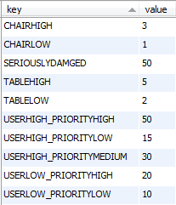
ANALYZE DATA AND MAKING DECISION
REPORT
Step 1:
Analyze data
Evaluate is “Không thể sử dụng”
CONFIGURATION
ROOM TYPE
Priority is “Cao”

Slide 86
ANALYZE DATA AND MAKING DECISION
REPORT
Step 1:
Analyze data
50
CONFIGURATION
ROOM TYPE

Slide 87
ANALYZE DATA AND MAKING DECISION
REPORT
Step 1:
Analyze data
50
CONFIGURATION
Evaluate is “Có thể sử dụng”
ROOM TYPE
Priority is “Thấp”

Slide 88
ANALYZE DATA AND MAKING DECISION
REPORT
Step 1:
Analyze data
50
CONFIGURATION
10
ROOM TYPE

Slide 89
ANALYZE DATA AND MAKING DECISION
REPORT
50
CONFIGURATION
10
ROOM TYPE
60

Slide 90
ANALYZE DATA AND MAKING DECISION
Step 2:
Making decision

Slide 91
ANALYZE DATA AND MAKING DECISION
Step 2:
Making decision
CONFIGURATION
Get seriously damage in database

Slide 92
ANALYZE DATA AND MAKING DECISION
Step 2:
Making decision
Get seriously damage in database
Is damage level larger than seriously damage ?

Slide 93
ANALYZE DATA AND MAKING DECISION
Step 2:
Making decision
Get seriously damage in database
Is damage level larger than seriously damage ?
NO
YES
Find available room and change room
Update damage for classroom. Finish.

Slide 94
FIND AVAILABLE ROOM

Slide 95
FIND AVAILABLE ROOM
Class Name: 302
Room Type: “Thông Dụng” with 30 slots, 2 air conditioner,

Slide 96
FIND AVAILABLE ROOM
Step 1:
Get undamaged classrooms
202
303
201
301
402
101
503
List undamaged classrooms

Slide 97
FIND AVAILABLE ROOM
Step 2:
Sort by floor
Class Name: 302
202
303
201
301
402
101
503
List undamaged classrooms

Slide 98
FIND AVAILABLE ROOM
Step 2:
Sort by floor
Class Name: 302
Sort
202
303
201
301
402
101
503
301
List undamaged classrooms

Slide 99
FIND AVAILABLE ROOM
Step 2:
Sort by floor
Class Name: 302
Sort
202
303
201
301
402
101
503
301
303
List undamaged classrooms

Slide 100
FIND AVAILABLE ROOM
Step 2:
Sort by floor
Class Name: 302
Sort
202
303
201
301
402
101
503
301
303
201
List undamaged classrooms

Slide 101
FIND AVAILABLE ROOM
Step 2:
Sort by floor
Class Name: 302
Sort
202
303
201
301
402
101
503
301
303
201
202
List undamaged classrooms

Slide 102
FIND AVAILABLE ROOM
Step 2:
Sort by floor
Class Name: 302
Sort
202
303
201
301
402
101
503
301
303
201
202
402
List undamaged classrooms

Slide 103
FIND AVAILABLE ROOM
Step 2:
Sort by floor
Class Name: 302
Sort
202
303
201
301
402
101
503
301
303
201
202
402
101
List undamaged classrooms

Slide 104
FIND AVAILABLE ROOM
Step 2:
Sort by floor
Class Name: 302
Sort
202
303
201
301
402
101
503
301
303
201
202
402
101
503
List undamaged classrooms
List sort by floor

Slide 105
FIND AVAILABLE ROOM
Step 3:
Compare with room type
Room Type: “Thông Dụng” with 30 slots, 2 air conditioner,…
301
303
201
202
402
101
503
List sort by floor

Slide 106
FIND AVAILABLE ROOM
Step 3:
Compare with room type
Room Type: “Thông Dụng” with 30 slots, 2 air conditioner,…
Compare
301
303
201
202
402
101
503
301
303
201
202
402
101
503
List sort by floor
Room Type is “Thông Dụng”

Slide 107
FIND AVAILABLE ROOM
Step 3:
Compare with room type
Room Type: “Thông Dụng” with 30 slots, 2 air conditioner,…
Compare
301
303
201
202
402
101
503
503
301
303
201
202
402
101
List sort by floor
Room Type is “Thông Dụng”

Slide 108
FIND AVAILABLE ROOM
Step 3:
Compare with room type
Room Type: “Thông Dụng” with 30 slots, 2 air conditioner,…
Compare
301
303
201
202
402
101
503
503
301
303
201
202
402
101
List sort by floor
Room Type is smaller than current Room Type

Slide 109
FIND AVAILABLE ROOM
Step 3:
Compare with room type
Room Type: “Thông Dụng” with 30 slots, 2 air conditioner,…
Compare
301
303
201
202
402
101
503
402
503
301
303
201
202
101
List sort by floor
Room Type is equal current Room Type

Slide 110
FIND AVAILABLE ROOM
Step 3:
Compare with room type
Room Type: “Thông Dụng” with 30 slots, 2 air conditioner,…
Compare
301
303
201
202
402
101
503
202
402
503
301
303
201
101
List sort by floor
Room Type is larger current Room Type

Slide 111
FIND AVAILABLE ROOM
Step 3:
Compare with room type
Room Type: “Thông Dụng” with 30 slots, 2 air conditioner,…
Compare
301
303
201
202
402
101
503
202
402
503
301
303
201
101
List sort by floor
Room Type is smaller than current Room Type

Slide 112
FIND AVAILABLE ROOM
Step 3:
Compare with room type
Room Type: “Thông Dụng” with 30 slots, 2 air conditioner,…
Compare
301
303
201
202
402
101
503
202
402
503
301
303
201
101
List sort by floor
Room Type is smaller than current Room Type

Slide 113
FIND AVAILABLE ROOM
Step 3:
Compare with room type
Room Type: “Thông Dụng” with 30 slots, 2 air conditioner,…
Compare
301
303
201
202
402
101
503
202
402
503
301
303
201
101
List sort by floor
Room Type is smaller than current Room Type

Slide 114
FIND AVAILABLE ROOM
Step 3:
Compare with room type
Room Type: “Thông Dụng” with 30 slots, 2 air conditioner,…
Compare
301
303
201
202
402
101
503
202
402
503
301
303
201
101
List sort by floor
List after compare

Slide 115
FIND AVAILABLE ROOM
Class Name: 302
Room Type: “Thông Dụng” with 30 slots, 2 air conditioner…
202
402
503
301
303
201
101
202
Result
List after compare

Slide 116
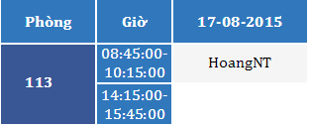
SCENARIO PROBLEM 1

Slide 117


SCENARIO PROBLEM 1
Classroom 113
Projector: “Không thể sử dụng được”
Air conditioning: “Không thể sử dụng được”
17-08-2015
09:00 AM
HoangNT

Slide 118
SCENARIO PROBLEM 1
17-08-2015
09:00 AM
Analyze
HoangNT

Slide 119
SCENARIO PROBLEM 1
17-08-2015
09:00 AM
Analyze
HoangNT
Update
Classroom 113
Damaged Level: 80%
IsDamaged: true

Slide 120
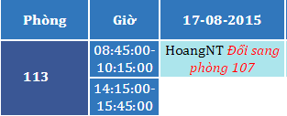
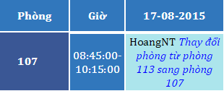
SCENARIO PROBLEM 1
17-08-2015
09:00 AM
Analyze
HoangNT
Change Room
Update
Classroom 113
Damaged Level: 80%
IsDamaged: true

Slide 121
SCENARIO PROBLEM 1
17-08-2015
09:00 AM
Analyze
HoangNT
Change Room
Update
Classroom 113
Damaged Level: 80%
IsDamaged: true

Slide 122
CHECK STATUS OF CLASSROOM
Time:
06:30 AM - 12:15 PM Every day
Actor:
System
Goal:
Checking current status of classroom
Make decision when needed

Slide 123
CHECK STATUS OF CLASSROOM
Step 1
Get all classrooms are damaged

Slide 124
CHECK STATUS OF CLASSROOM
Step 1
Get all classrooms are damaged
Step 2
Find available room to change

Slide 125
CHECK STATUS OF CLASSROOM
Step 1
Get all classrooms are damaged
Step 2
Find available room to change
Step 3
Change room and notice to teacher

Slide 126
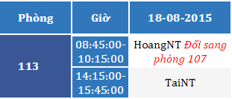
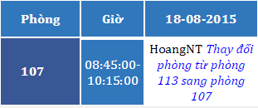
SCENARIO PROBLEM 2
17-08-2015
09:00 AM
Analyze
HoangNT
Change Room
Update
18-08-2015
06:30 AM
Classroom 113
Damaged Level: 80%
IsDamaged: true
126

Slide 127
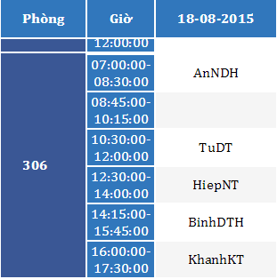
SCENARIO PROBLEM 3
18-08-2015
08:15 AM
Mr. AnNDH
306
Projector: “Không thể sử dụng được”

Slide 128
SCENARIO PROBLEM 3
18-08-2015
08:15 AM
Analyze data
Mr. AnNDH
Update
Classroom 306
Damaged Level: 80%
IsDamaged: true

Slide 129
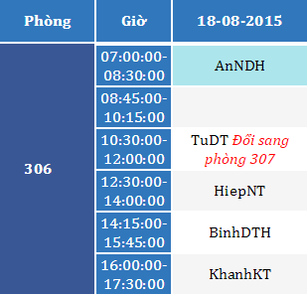
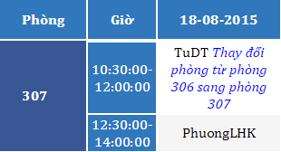
SCENARIO PROBLEM 3
18-08-2015
08:15 AM
Analyze data
Mr. AnNDH
Change Room
Update
Classroom 306
Damaged Level: 80%
IsDamaged: true

Slide 130
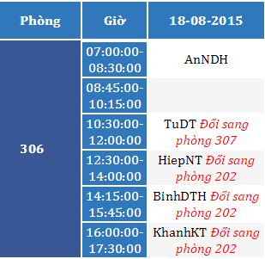
SCENARIO PROBLEM 3
18-08-2015
08:15 AM
Analyze data
Mr. AnNDH
Change Room
Update
18-08-2015
12:15 PM
Classroom 306
Damaged Level: 80%
IsDamaged: true

Slide 131
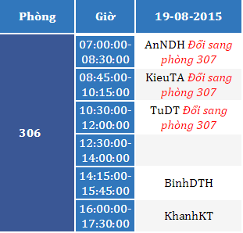
SCENARIO PROBLEM 3
18-08-2015
08:15 AM
Analyze data
Mr. AnNDH
Change Room
Update
19-08-2015
06:30 AM
Classroom 306
Damaged Level: 80%
IsDamaged: true

Slide 132
SCENARIO PROBLEM 4
Classroom 113
Damaged Level: 80%
IsDamaged: true
Classroom 306
Damaged Level: 50%
IsDamaged: true

Slide 133
SCENARIO PROBLEM 4
Classroom 113
Damaged Level: 80%
IsDamaged: true
Classroom 306
Damaged Level: 50%
IsDamaged: true
306
Resolve

Slide 134
SCENARIO PROBLEM 4
Classroom 113
Damaged Level: 80%
IsDamaged: true
Classroom 306
Damaged Level: 50%
IsDamaged: true
306
Classroom 306
Damaged Level: 0%
IsDamaged: false
Resolve

Slide 135
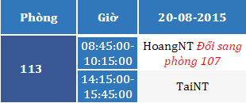
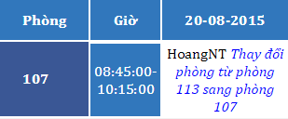
SCENARIO PROBLEM 4
20-08-2015 12:15 PM

Slide 136
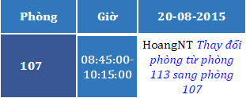
SCENARIO PROBLEM 5
Mr. HoangNT

Slide 137
SCENARIO PROBLEM 5
20-08-2015
09:00 AM
107
Projector: “Không thể sử dụng được”
Speaker: “Không thể sử dụng được”
Mr. HoangNT

Slide 138
SCENARIO PROBLEM 5
20-08-2015
09:00 AM
Analyze data
Mr. HoangNT
Update
Classroom 107
Damaged Level: 80%
IsDamaged: true

Slide 139

SCENARIO PROBLEM 5
20-08-2015
09:00 AM
Analyze data
Mr. HoangNT
Change Room
Update
Classroom 107
Damaged Level: 80%
IsDamaged: true

Slide 140
SCENARIO PROBLEM 5
113
Resolve

Slide 141
SCENARIO PROBLEM 5
113
Resolve
Classroom 113
Damaged Level: 0%
IsDamaged: false

Slide 142

SCENARIO PROBLEM 5
113
Resolve
Classroom 113
Damaged Level: 0%
IsDamaged: false
21-08-2015 06:30 AM
Back to classroom 113

Slide 143
ADVANTAGE & DISADVANTAGE
Advantage
Require less human source
Save time when receive and resolve report
Easy to check status of equipment, classroom
User interface is friendly, easy to use.
Disadvantage
Can not check user behavior.
Only support for Android OS.

Slide 144
FUTURE PLAN
Synchronize schedule with Google Calendar
Support other mobile OS

Slide 145
Question and Answer

